Slide 1
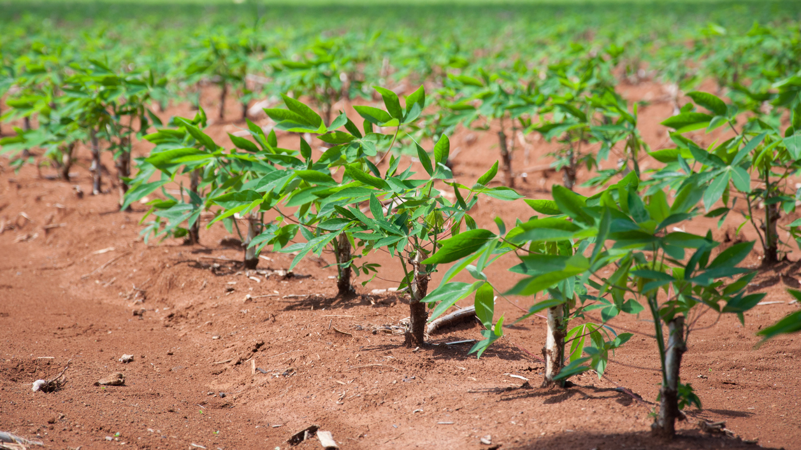
Identify Type of Disease from Image of Cassava Leaves with Deep Learning Methods
Hanlin Tang, Yuechuan Chen, Hua Tong
This Photo by Unknown Author is licensed under CC BY-NC-ND

Slide 2
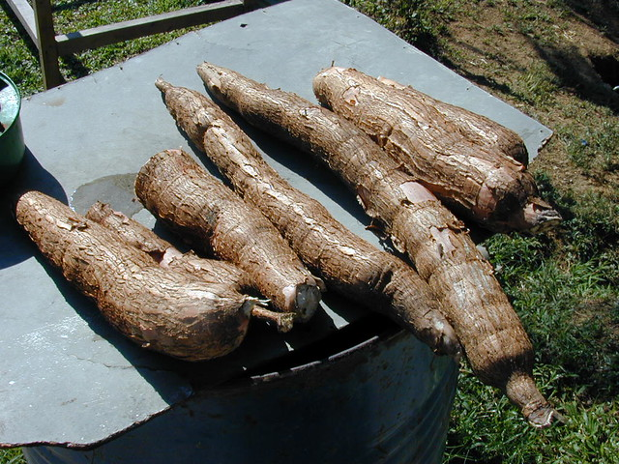
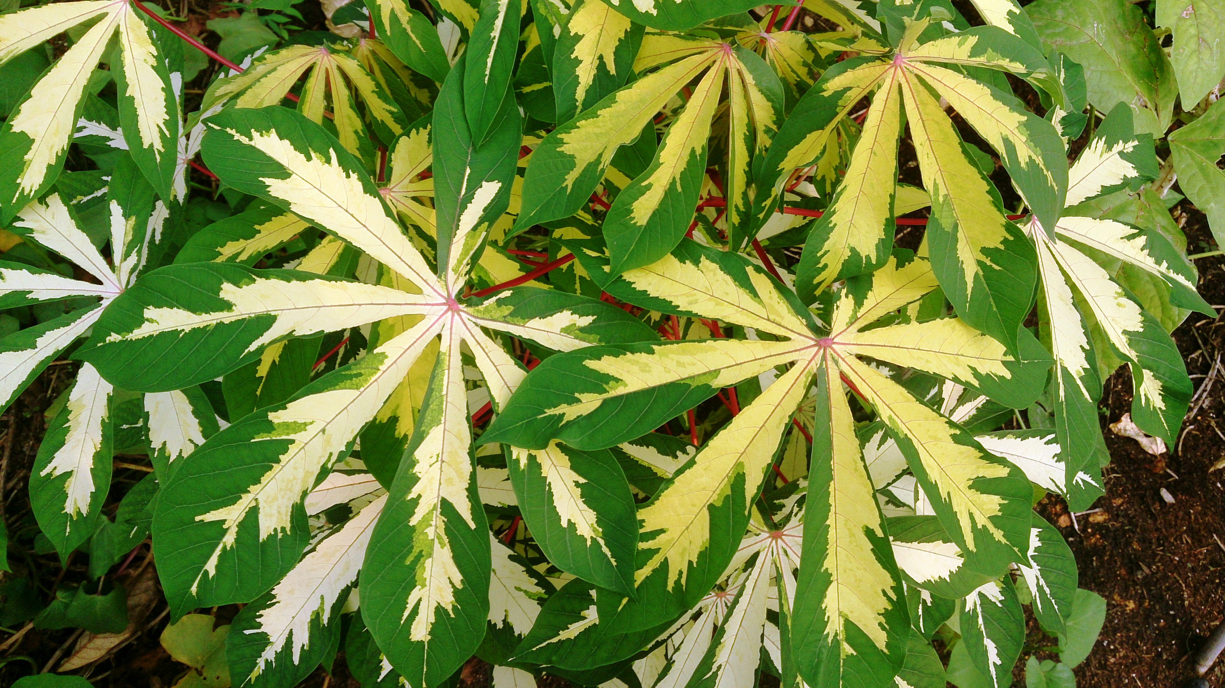
Contents
Background and Motivation
Methods and Models
Experiment Details
Result and Conclusion

Slide 3
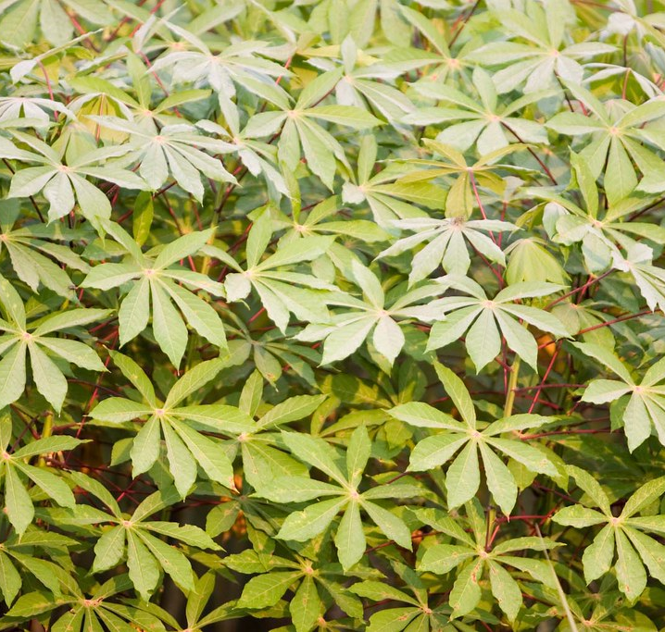
Background and Motivation

Slide 4
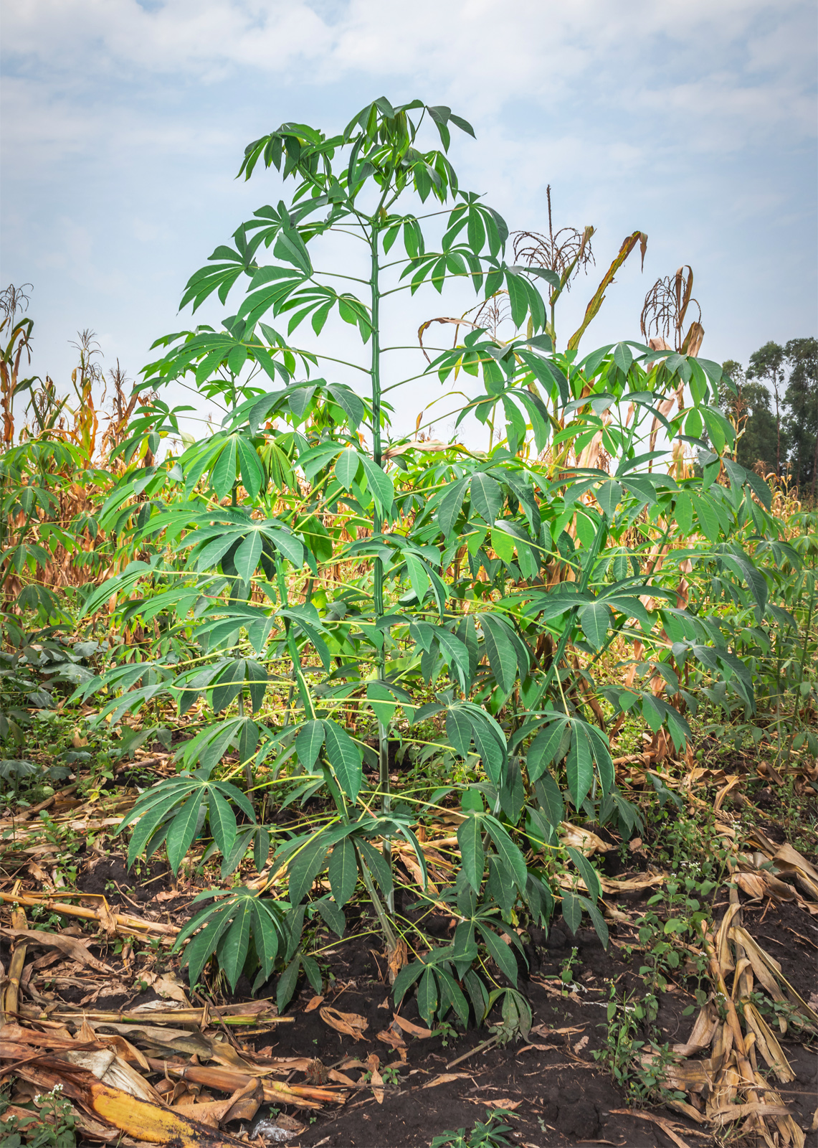
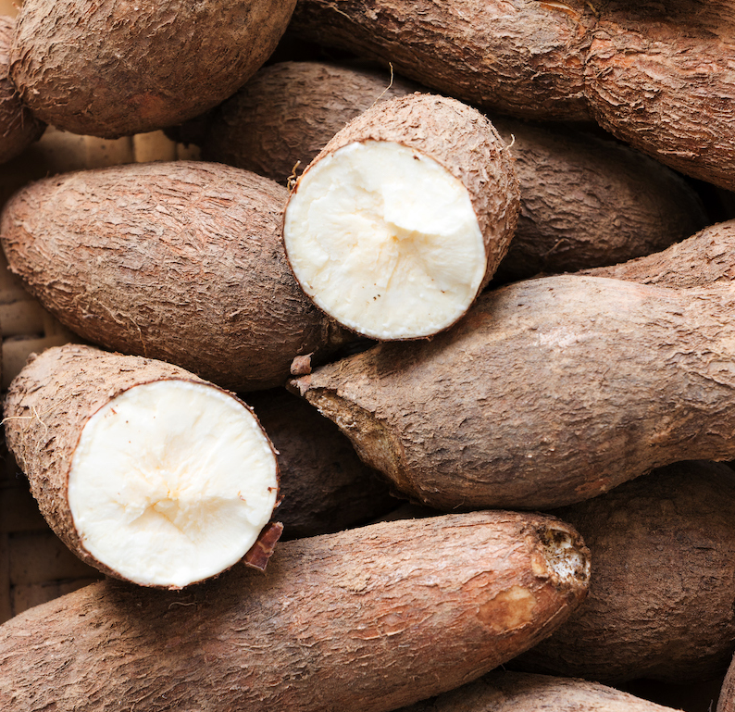
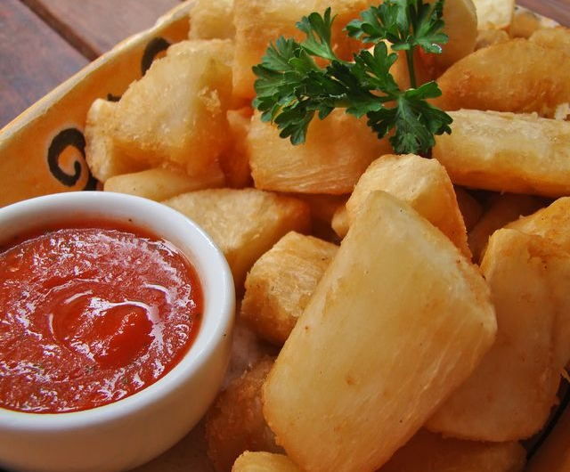
Background
Cassava, a major staple food in the developing world that plays a vital role in saving the world from hunger.
At least 80% of household farms in Sub-Saharan Africa grow it.
However, there are viral diseases that preventing good yields.

Slide 5
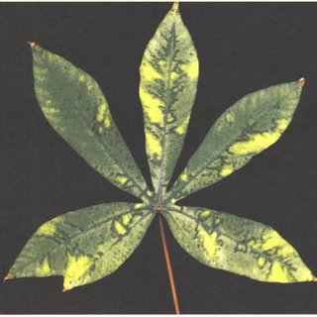
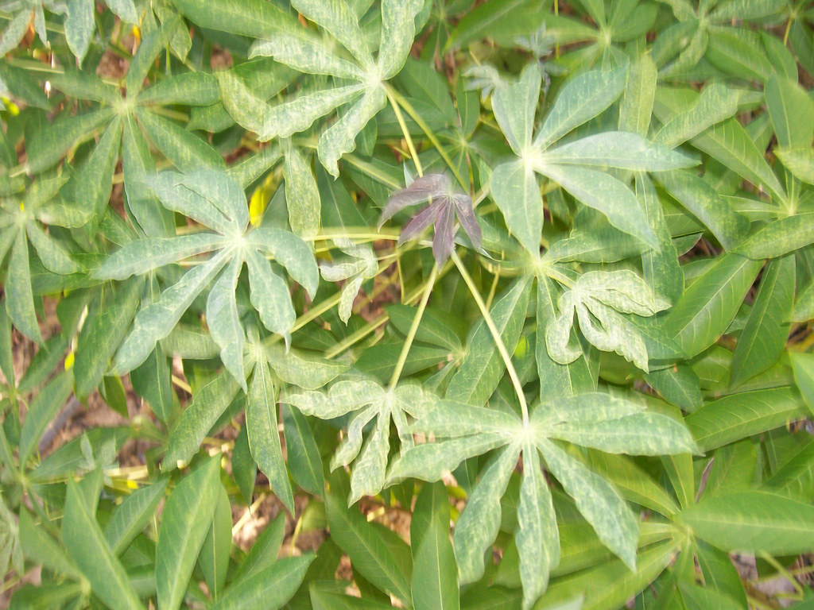
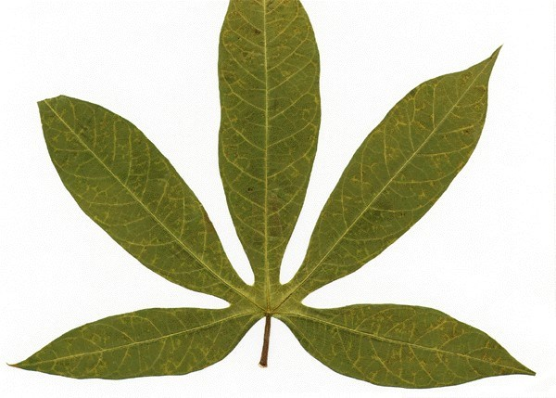
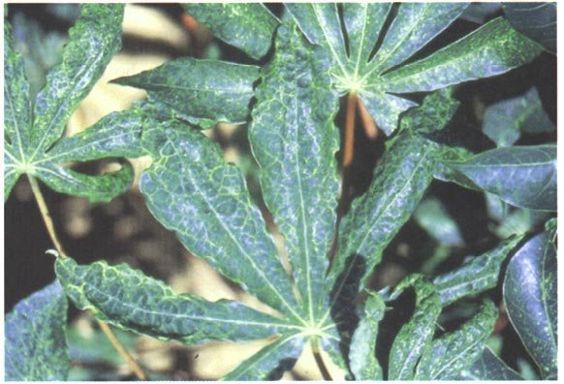
Diseases
Cassava Bacterial Blight (CBB)
Cassava Brown Streak Disease (CBSD)
Cassava Green Mottle (CGM)
Cassava Mosaic Disease (CMD)

Slide 6
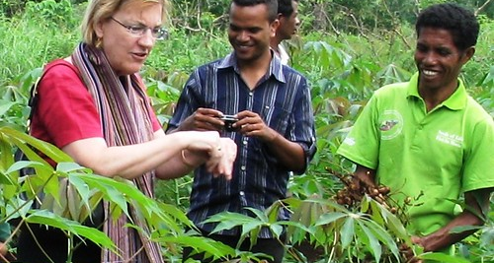
Motivation
Existing detection methods require the involvement of experts’ inspection, which suffers from being labor-intensive, costly, and sometime inaccessible.
Meanwhile, find out the infected plants sooner could help stopping it from spreading.
Thus, “identifying disease with image” comes to be an option.

Slide 7
Methods and Models
This Photo by Unknown Author is licensed under CC BY

Slide 8
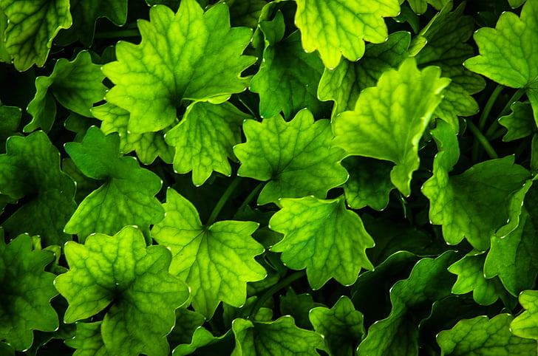
Models
Convolutional Neural Network
AlexNet
VGGNet
ResNet
GoogLeNet
ResNeXt
Wide ResNet

Slide 9
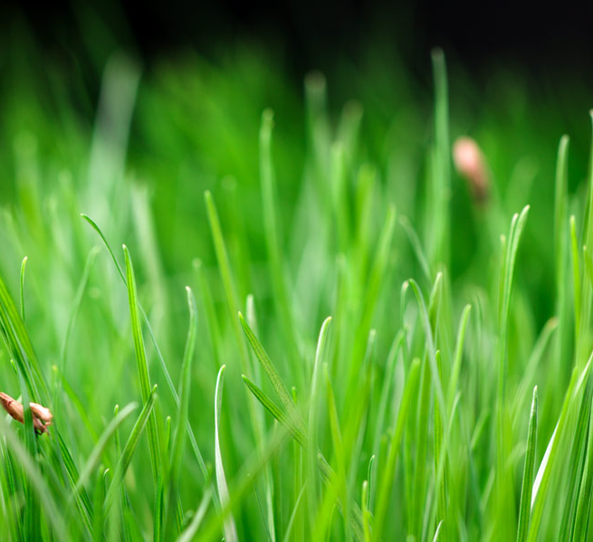
Optimizing
SGD
SGD, fully expressed as Stochastic gradient descent, originally referred to the optimizing strategy that update parameters for each single sample. Since the direction for a single sample could be very different from the direction of the whole data set, there is this ”stochastic” introduced.
此照片，作者: 未知作者，许可证: CC BY-NC-ND

Slide 10
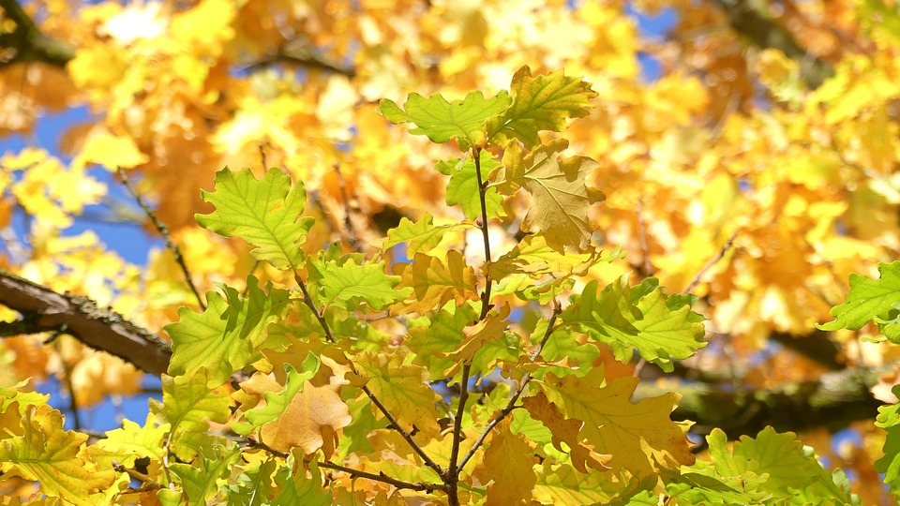
Optimizing
Adam
Adam, Adaptive Moment Estimationan， algorithm for first-order gradient-based optimization of stochastic objective functions, based on adaptive estimates of lower-order moments.
The method is straightforward to implement, is computationally efficient, has little memory requirements, is invariant to diagonal rescaling of the gradients, and is well suited for problems that are large in terms of data and/or parameters.
此照片，作者: 未知作者，许可证: CC BY-NC-ND

Slide 11
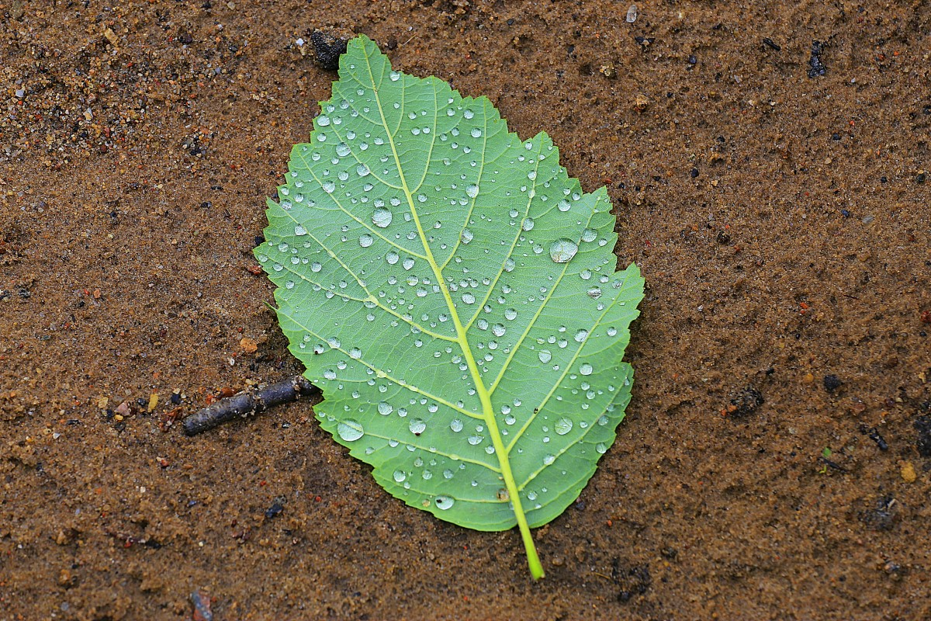
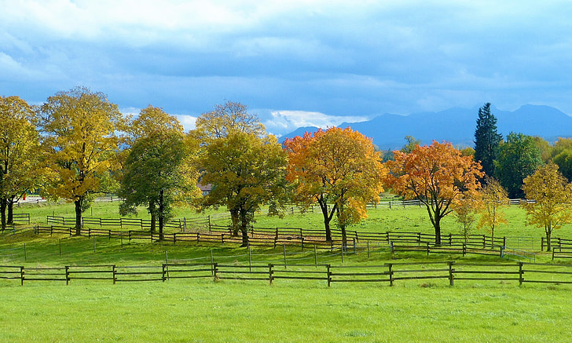
Optimizing
Early Stopping
Early stopping, as the name stating, is to stop training earlier than our pre-determined epoch number. There are many criteria for doing early stopping, while most of them are based on the validation accuracy.
We designed such an early stopping strategy: “Stop if the max validation accuracy does not increase for 6 epochs, or does not increase for 2 epochs while train accuracy is larger than 99%.”

Slide 12
Experiment Details
This Photo by Unknown Author is licensed under CC BY

Slide 13

Data Set
Numbers
Each Data
80% training data (17118)
5% validation data (1070)
15% test data (3209)
Around 15000 online test data (not visible)
An RGB 3 channel, 800x600 image
During training, we resize to 400x300 for efficiency
For pretrained models, we normalize with mean [0.485, 0.456, 0.406] and std [0.229, 0.224,0.225]

Slide 14



Environment
Software
Hardware
Pytorch on python, including it’s embedded models (torchvision.models).
Overleaf for report, and Powerpoint for slides.
One GTX 1650, one RTX 2080, and one RTX 2080 Ti.

Slide 15
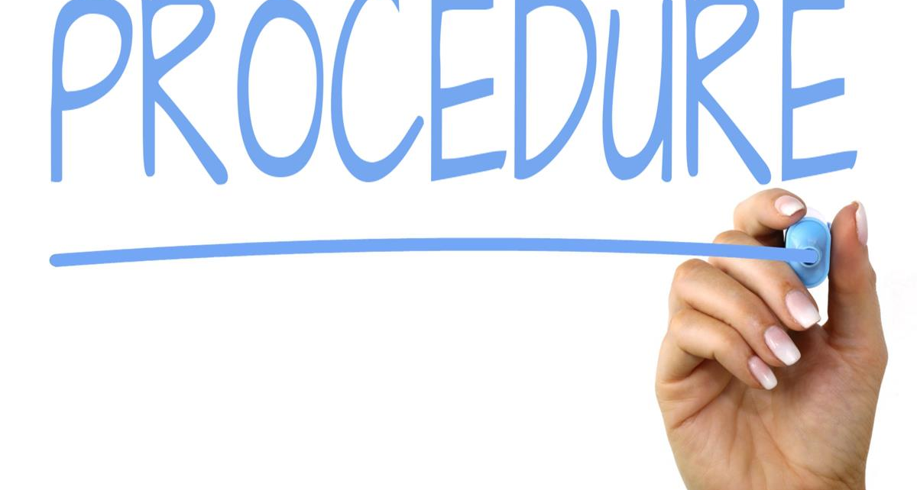
General procedure
Initial tuning
fine-tuning
Load model from pytorch package
Train at most 40 epochs with the early stopping setting
Generally, use SGD with 0.001 learning rate or 0.0001 learning rate, depends on the result.
Only tried on Resnet due to lack of resources.
Make necessary change to the architecture
Manually adjust learning rate
Run less epoch each time and keep improving

Slide 16
Result and Conclusion
This Photo by Unknown Author is licensed under CC BY

Slide 17

Diseases

Slide 18


Table
 | Category 1 | Category 2 | Category 3 | Category 4
Item 1 | 4.5 | 2.3 | 1.7 | 5
Item 2 | 3.2 | 5.1 | 4.4 | 3
Item 3 | 2.1 | 1.7 | 2.5 | 2.8
Item 4 | 4.5 | 2.2 | 1.7 | 7

Slide 19

The way to get started is to quit talking and begin doing.
Walt Disney

Slide 20
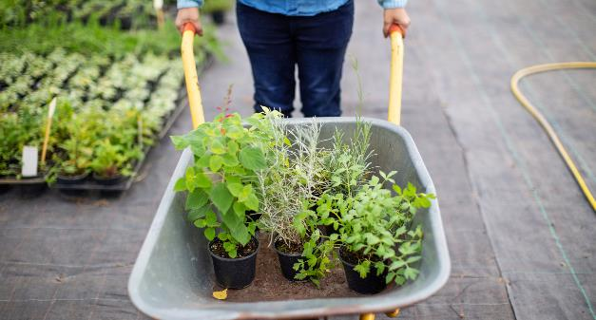
Two Content
Subtitle
Subtitle
Add text, images, art, and videos.
Add transitions, animations, and motion.
Save to OneDrive, to get to your presentations from your computer, tablet, or phone.
Open the Design Ideas pane for instant slide makeovers.
When we have design ideas, we’ll show them to you right there.

Slide 21
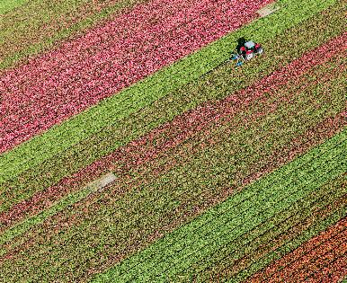
Three Content
Subtitle
Subtitle
Subtitle
Add text, images, art, and videos.
Add transitions, animations, and motion.
Save to OneDrive, to get to your presentations from your computer, tablet, or phone.
Open the Design Ideas pane for instant slide makeovers.
When we have design ideas, we’ll show them to you right there.
This PowerPoint theme uses its own unique set of colors, fonts, and effects to create the overall look and feel of these slides.
PowerPoint has tons of themes to give your presentation just the right personality.

Slide 22
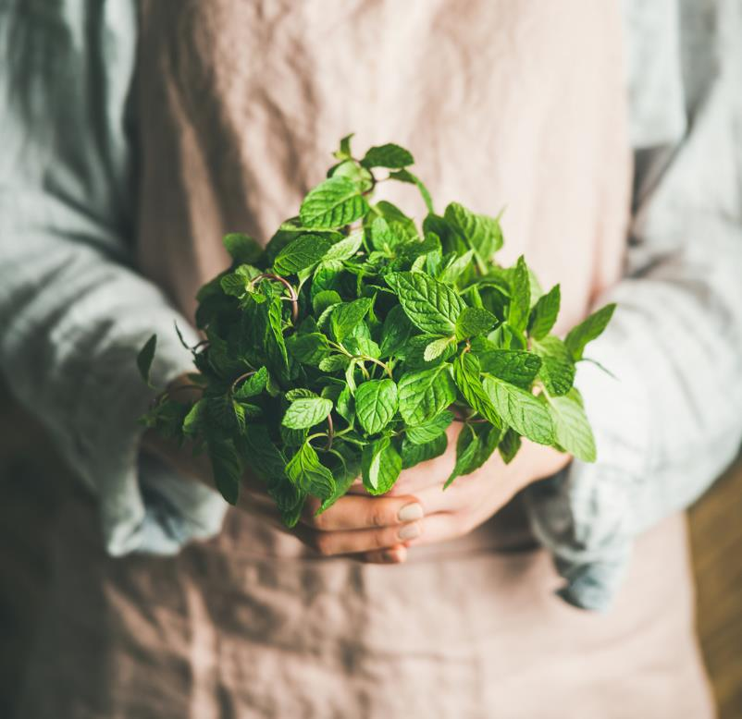
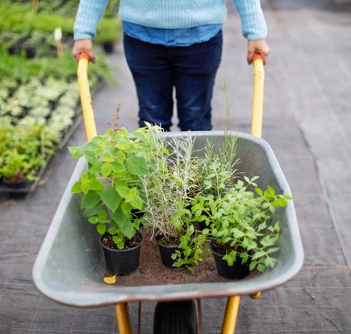
Conclusion
We practiced our skills in deep learning and meet the target we set at the beginning of the project.
We also learned the complexity of tuning and how cost it could be to run deep learning training.
The final result, though not outstanding, is pretty usable.

Slide 23
Thank You
Hanlin Tang, htang79@wisc.edu
Yuechuan Chen, ychen959@wisc.edu
Hua Tong, htong24@wisc.edu
Github: https://github.com/Tonghua35/453-Final-Project

